Slide 1
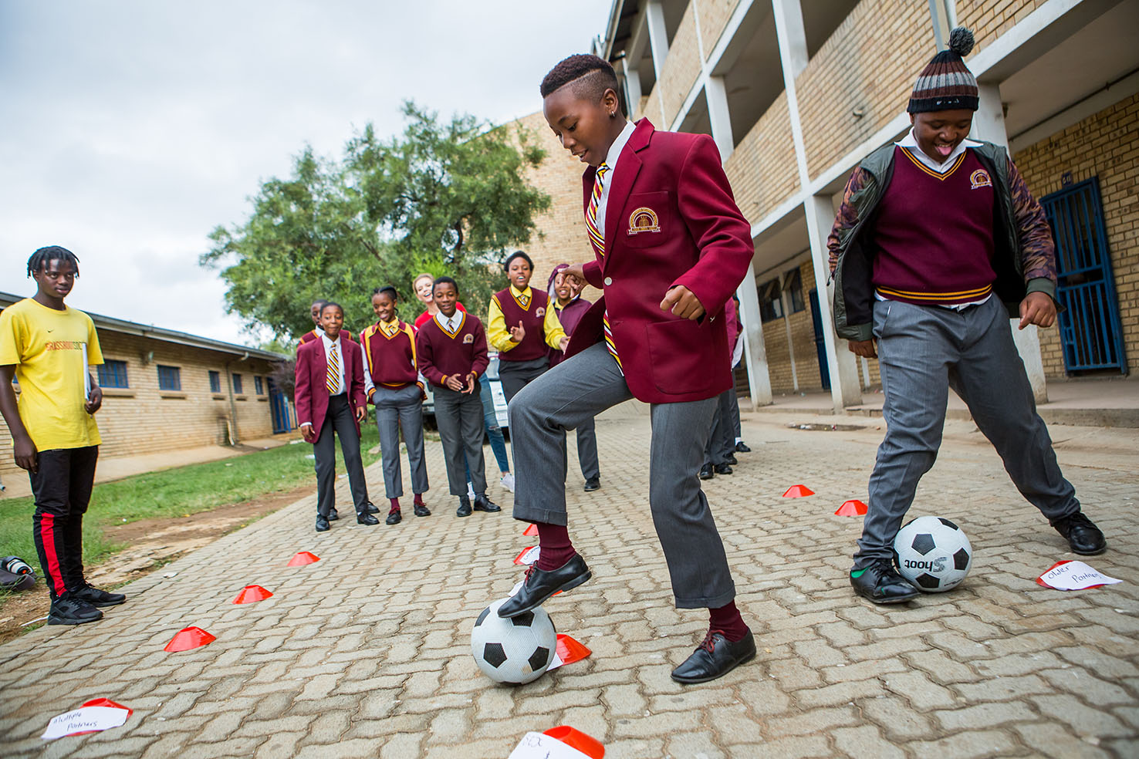



CHANGING THE GAME IN
ADOLESCENT-CENTERED DESIGN:
ASSETS, ACCESS, ADHERENCE
#changingthegame #AIDS2108
Please tag @grassrootsoccer

Slide 2
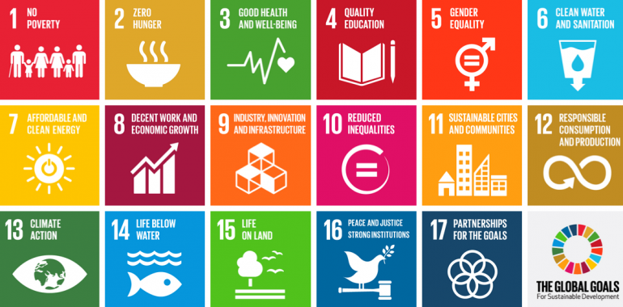

ADOLESCENT HEALTH IN THE SDGs

Slide 3

ADOLESCENT HEALTH IN THE SDGs
Ensure healthy lives and promote well-being of adolescents
Ensure inclusive and equitable quality education
Achieve gender equality and empower all girls and women
Empower and promote social, economic and political inclusion of all
Reduce violence, abuse and related deaths
Encourage and promote effective public, private and civil society partnerships

Slide 4
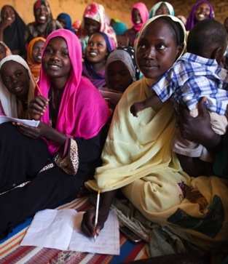
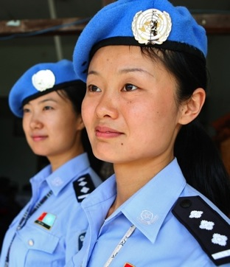

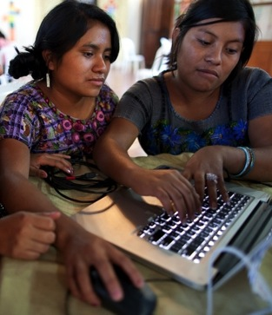
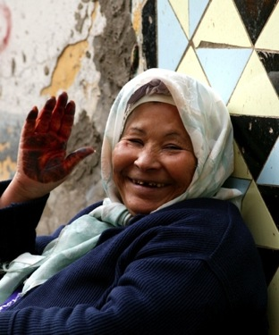
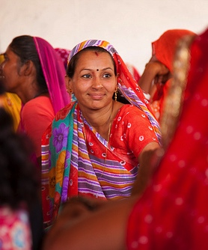
Adolescent Health and the SDGs: Extending the HIV Infrastructure to Achieve Universal Health Coverage for Adolescents
22 July 2018
Nazneen Damji, Policy Advisor, Gender Equality, HIV and Health

Slide 5








Creating New Slides
Gender Equality in the Context of SDGs
Globally, there are 122 women (25-34 years) living in extreme poverty for every 100 men in the same age group.
Only 52% of women married or in a union freely make their own decisions about sexual relations, contraceptive use and health care.
Based on comparable data from 50 countries, an estimated 15 million adolescent girls (aged 15–19) report experiencing forced sex in their lifetime.
Women are up to 11 percent more likely than men to report food insecurity.
In 18 countries, husbands can legally prevent their wives from working; in 39 countries, daughters and sons do not have equal inheritance rights; and 49 countries lack laws protecting women from domestic violence.
Complications related to childbirth and pregnancy are among the leading causes of death for girls aged 15–19.
15 million girls of primary-school age will never get the chance to learn to read or write in primary school, compared to 10 million boys.
Women and girls are responsible for water collection in 80% of households without access to water on premises.
Source: UN Women 2018. Turning Promises into Action: Gender Equality in the 2030 Agenda for Sustainable Development.

Slide 6
CHANGING THE GAME IN
ADOLESCENT-CENTERED DESIGN:
ASSETS, ACCESS, ADHERENCE
#changingthegame #AIDS2108
Please tag @grassrootsoccer

